Slide 1
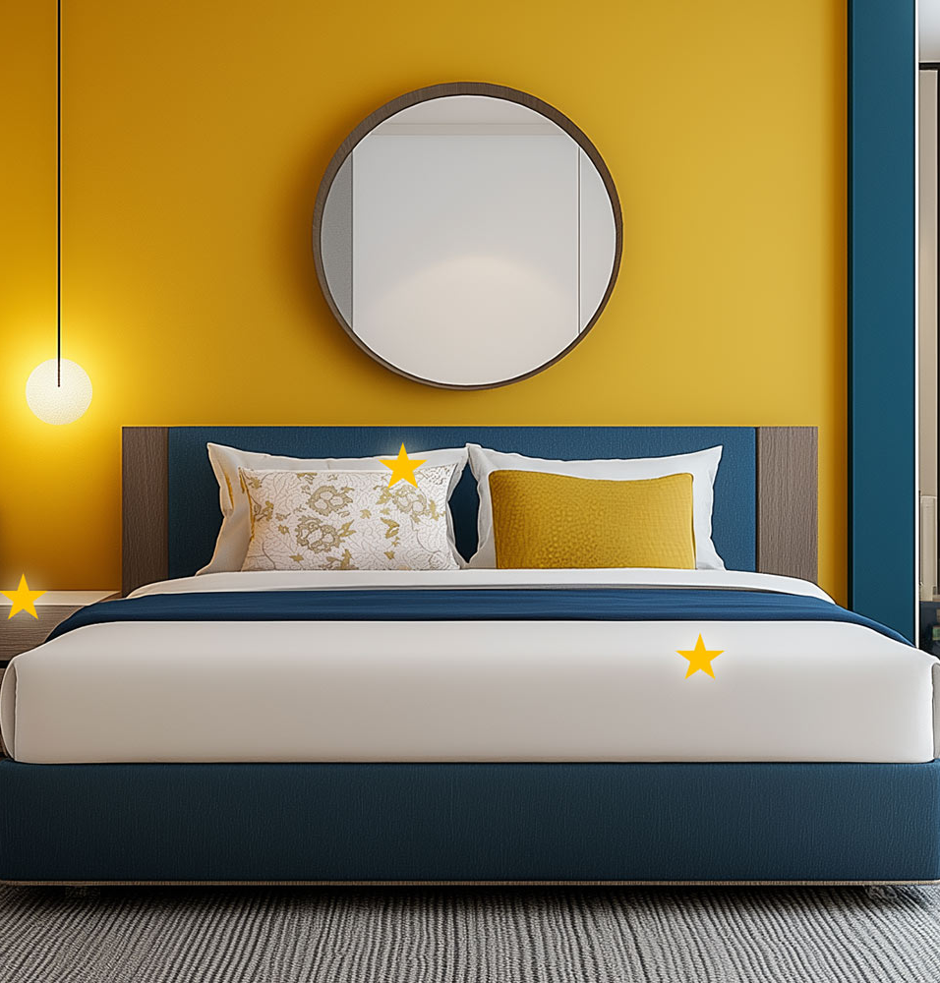
HOTELSTARS UNION –
THAT‘S WHO WE ARE
Maria Dinböck
General Secretary
Hotelstars Union AISBL

Slide 2
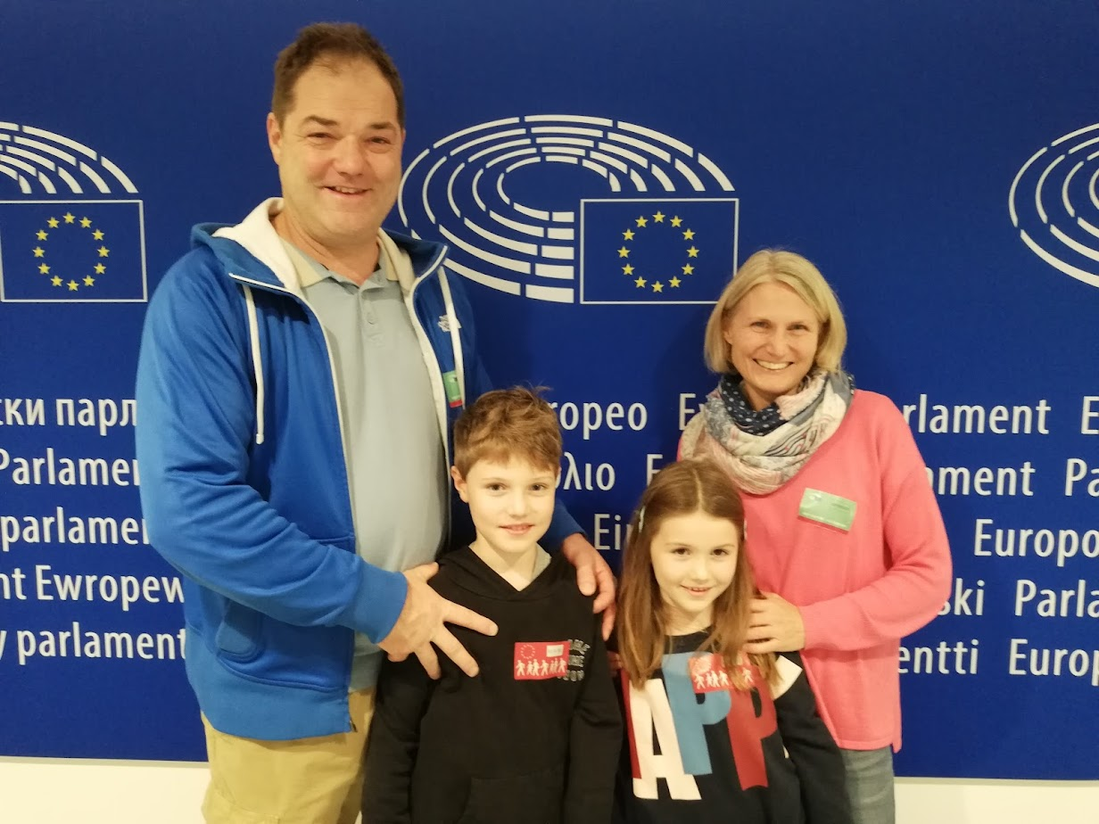
THAT‘S WHO I AM
Maria Dinböck
Hotelstars Union Secretary General
(since 2021)
Austrian Professional Hotel Association (APHA)
(since 2018)
Austrian Federal Economic Chamber
(since 2004)

Slide 3



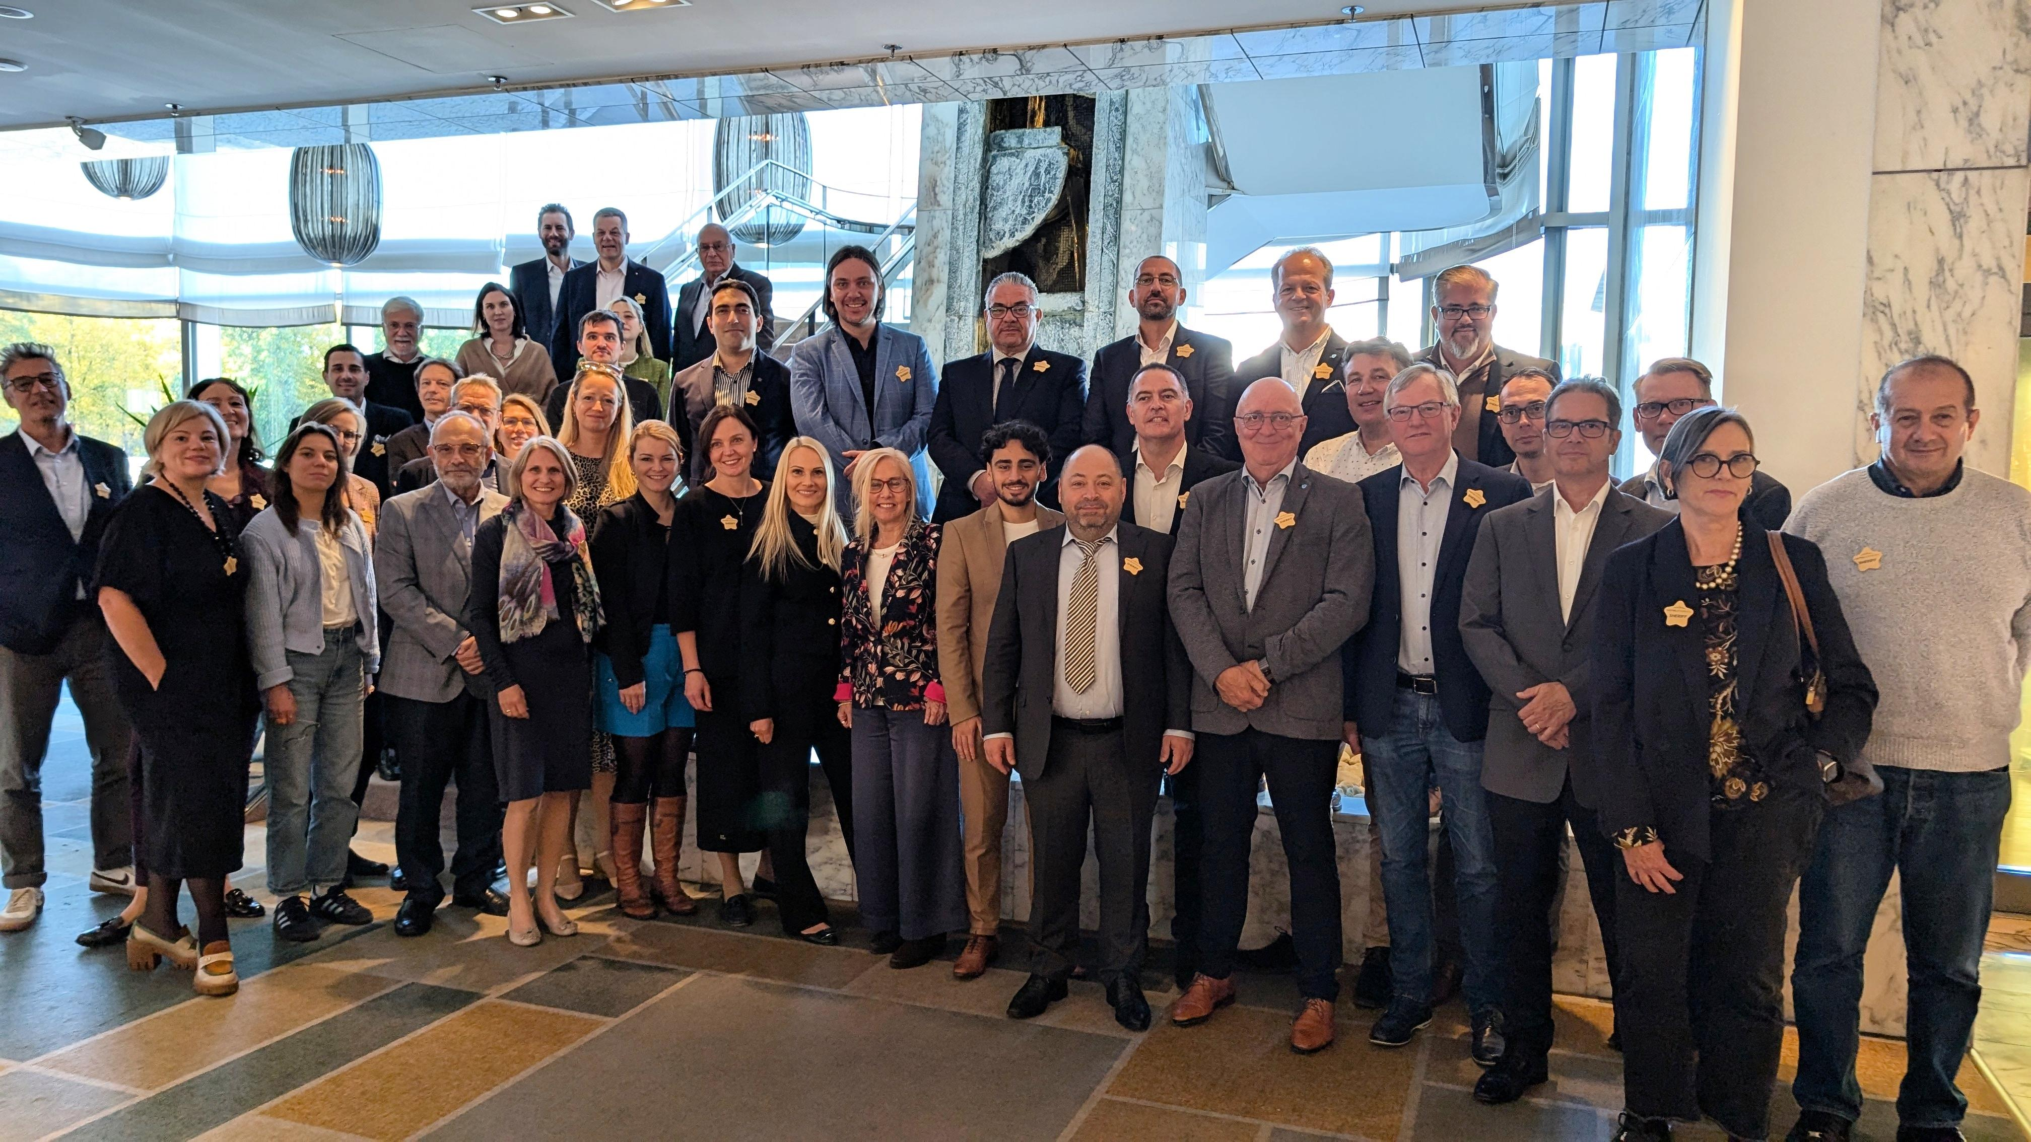
THAT’S WHO WE ARE
Establishing Harmony: The Development of HSU
AISBL Incorporation
15th Anniversary
2009
2011
2012
2013
2015
2017
2020
2021
2022
2023
2024

Slide 4
THAT’S WHO WE ARE
21 Members & 5 Observers
Full Members
Aserbaidschan
Belgien
Dänemark
Deutschland
Estland
Lettland
Liechtenstein
Litauen
Luxemburg
Malta
Niederlande
Österreich
Schweden
Schweiz
Slowenien
Tschechien
Ungarn
Associate Members
Armenien
Georgien
Griechenland
Polen
Observers
Frankreich
Irland
Italien
Slowakei
Ukraine

Slide 5
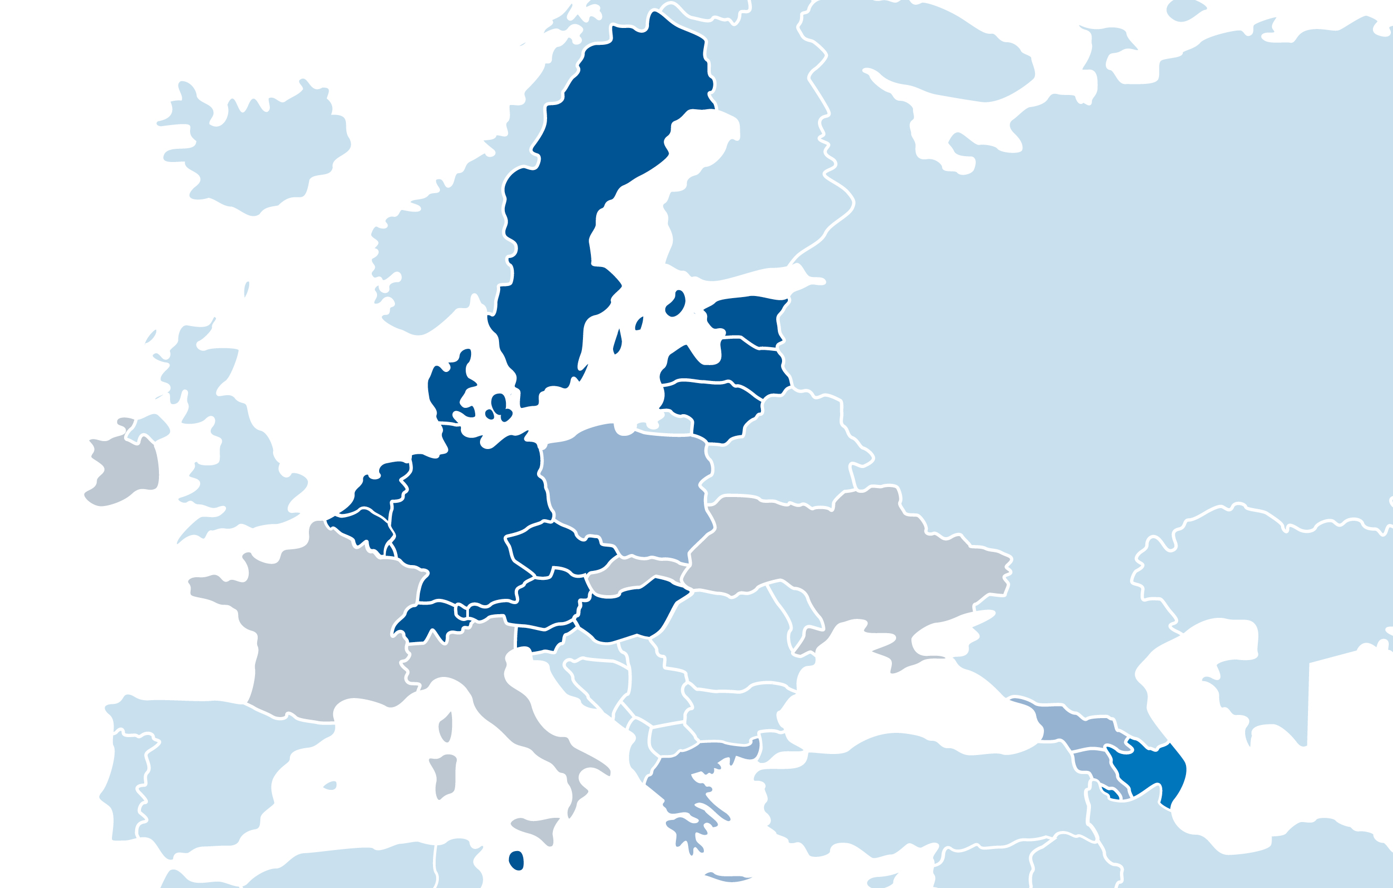

Estonia: “Joining the Hotelstars Union has brought consistency and transparency to hotel classification in Estonia, aligning our standards with a trusted international system. It’s a great tool and as a bonus comes dedicated network of colleagues in HSU family for support and networking.“
THAT’S WHO WE ARE
Quotes from HSU Countries
Luxembourg: “The HSU classification makes hotel stars comparable across Europe creating transparency and a degree of security for customers.“
“Lithuania's participation in the European Hotelstars classification system is crucial for ensuring standardized quality and transparency in the hospitality industry. Being part of the HSU family strengthens Lithuania's reputation as a reliable and professional destination, attracts more tourists and boosts the local economy.”
Malta: “The search for standardization of the star-rating system for hotels was always a struggle, and therefore, an opportunity to join such a community across Europe was not to be missed. Through the membership, Malta gained access to the standard that is recognized across Europe, networking opportunities, resources, and support.”
Slovenia: “The Hotelstars criteria represent unified criteria for the categorization of hotels in most of European countries, which is very important for Slovenia, because in this way we offer guests information about the guaranteed quality they can expect.“

Slide 6





















THAT’S WHO WE ARE
Portfolio of Classification Systems
organised by authority
mandatory
voluntary
organised by association

Slide 7




hsu Classification System
Building Trust Through Unified Hotel Classification
21 Principles need to be accepted to become a Member
Guidelines for implementing the HSU Classifiction Structure
100 % on-site Inspections

Slide 8
hsu Classification System
Building Trust Through Unified Hotel Classification
21 Principles need to be accepted to become a Member
Guidelines for implementing the HSU Classifiction Structure
100 % on-site Inspections

Slide 9

HSU CRITERIA
The Backbone: Common Criteria Catalogue
What is the Common Criteria Catalogue?
Unified standards across countries (239 criteria)
Reviewed every five years to meet modern hospitality trends
Based on guests’ expectations and market needs

Slide 10
HSU CRITERIA
Revision Process
2015
2010
2020
2025
REVISION CYCLES
Connectivity
European
Approach
Digitalisation,
Sustainability
Staff Shortage,
Climate Change

Slide 11
HSU CRITEria
Revision Process
2010
2015
2020
2025
REVISION CYCLES
European
Approach
Connectivity
Digitalisation,
Sustainability
Staff Shortage,
Climate Change

Slide 12
REVISION PROCESS
National
Implementation
Hotelstars Union
Guest-Reviews & Research
Hotels / Member Associations
Bottom-up Approach

Slide 13
HSU CRITERIA
The Backbone: Common Criteria Catalogue
Key Features of the 2025–2030 Catalogue:
Service Flexibility: Adapted hours for reception and room service
Digitalisation: Self-check-in/out, digital directories
Sustainability: Eco-friendly practices & carbon footprint tracking

Slide 14
HSU CRITERIA
Key Features of the 2025–2030 Catalogue
Service Flexibility
Digitalisation
Sustainability
Reduced reception hours
1 & 2 stars
Fully automated check-in /out possible
New acquisition of mattresses after 5 years
Cleaning of mattresses instead of replacing them
Restaurant opening days:
5 days for 4* removed
1*-4*: number of opening days not specified
(days must be indicated on the website)
5*: 7 days per week
Identifiable permanent socket in the room
Information on public transport connections on website
Change of towels not daily but on demand
Secure bicycle storage
Vending machine OR 24-hour self-service kiosk as an alternative to minibar
Change of linen once a week with option to opt-out
Bilingual* hotel own website with updated information including the bed sizes and realistic pictures together with the location of the hotel and information on public transport connections
Pen and notepad no longer a must in 3*-5*
Sewing kit and shoe polishing kind in the room
Reduced room service hours
Service hours can be split according to individual core hours
CO-2 footprint with the standard of HCMI
Room cleaning and change of linen with option to opt-out
*Website can be translated automated

Slide 15
HSU CRITERIA
Digitalisation / Service Flexibility
⬇ | ⬇⬇ | ⬇⬇⬇ | ⬇⬇⬇⬇ | ⬇⬇⬇⬇⬇
24-hour guest assistance (digitally or by phone) 1*-5*
1 point
5 points
5 points
10 points
15 points
20 points
8 hours physical availability in the hotel
OR
24 hours self-check-in and -out
8 hours physical availability in the hotel
OR
24 hours self-check-in and -out
10 hours physical availability in the hotel
OR
8 hours physical availability, additionally 24 hours self-check-in and -out
14 hours staffed reception,
24 hours physically available on request
24 hours staffed reception
NEW
Reception service, available for digital communication or phone calls 24 hours
Reception service, available for digital communication or phone calls 24 hours
10 hours staffed reception service, available for digital communication or phone calls 24 hours
16 hours staffed reception service, physically available for digital communication or phone calls 24 hours
24 hours staffed reception service, physically available for digital communication or phone calls 24 hours
OLD
1 Pkt
1 Pkt
7 points
10 points
15 points

Slide 16
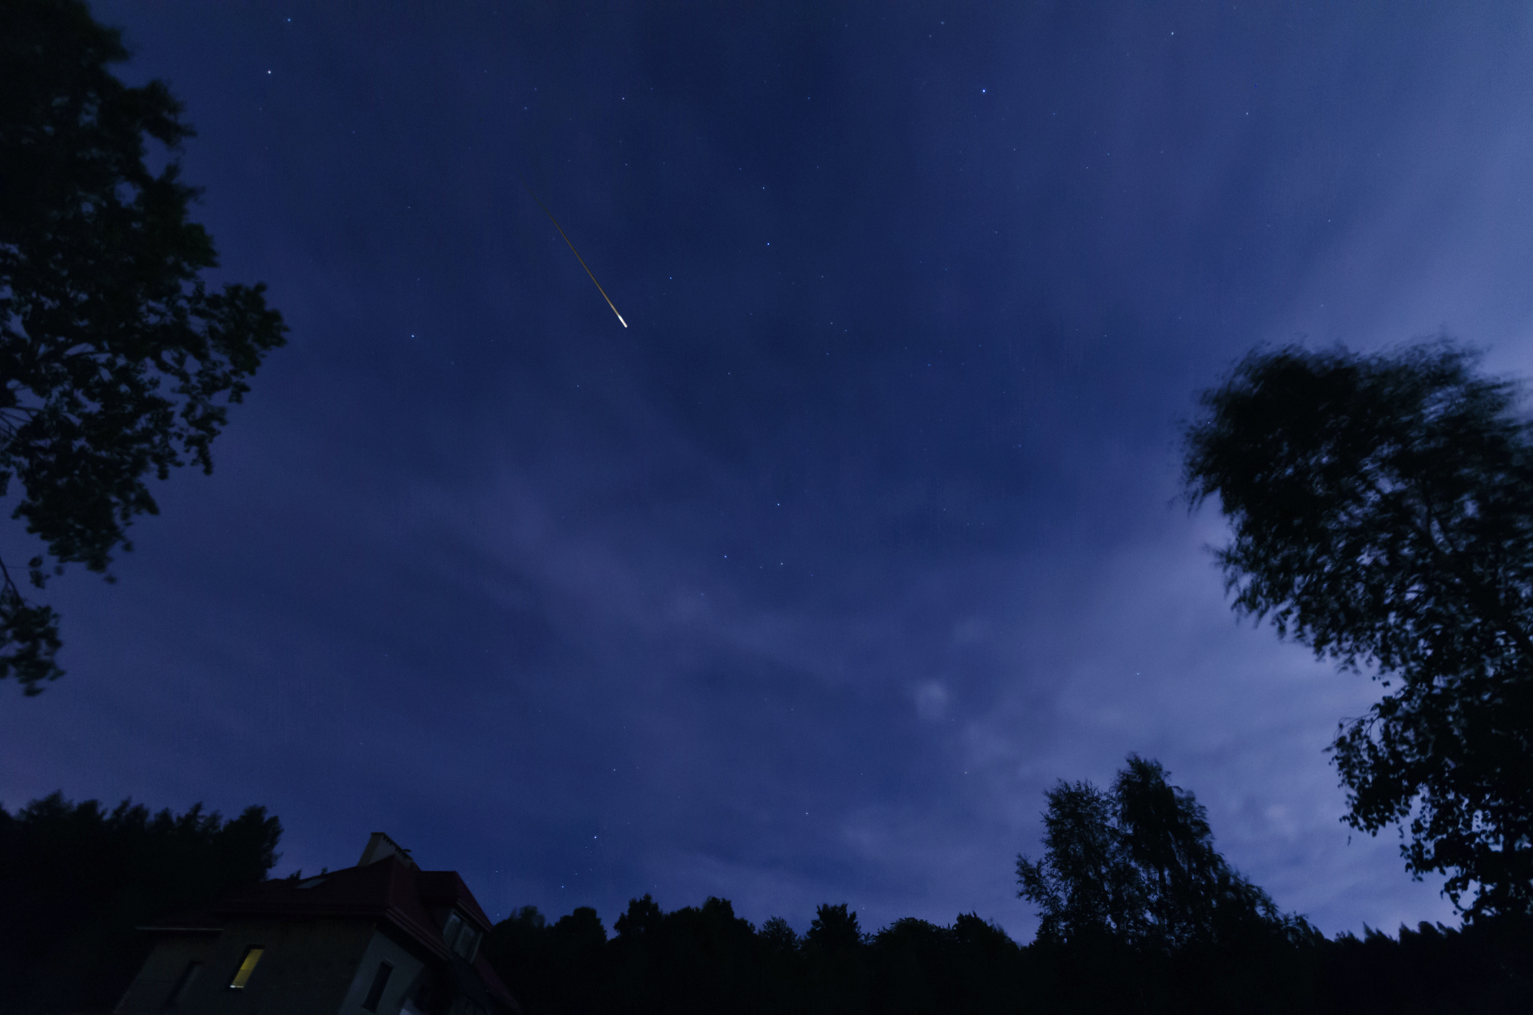
WHY DO HOTEL STARS MATTER MORE THAN EVER?
Hotelstars vs. Reviews
Don‘t stars fade out anyway…?
Source: Pjacek Halicki, Wikimedia Commons, CC BY-SA 4.0

Slide 17

“Stars are the most used filter we have on Booking.com“
- Olivier Grémillon, Vice President Global Segments, Booking.com -
Source: https://skift.com/2019/10/15/booking-coms-new-star-ratings-for-short-term-rentals-shake-sector/

Slide 18

WHY DO HOTEL STARS MATTER MORE THAN EVER?
Hotelstars vs. Reviews
    Pre-selection from
    an oversized offer
    Final safeguarding
    of the decision
Star ratings and reviews serve different purposes!

Slide 19
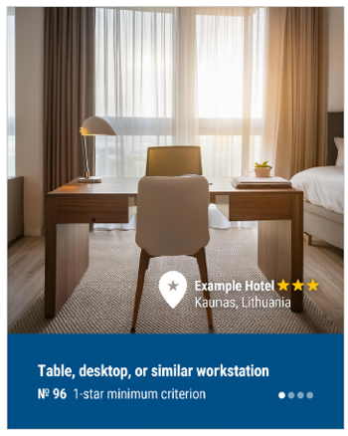
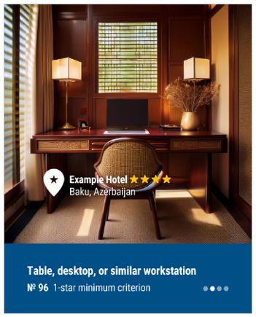
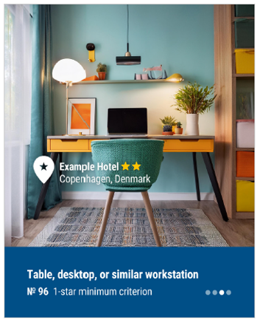

Generated Facts: The AI Illusion of Hotels
WHY DO HOTEL STARS MATTER MORE THAN EVER?

Slide 20
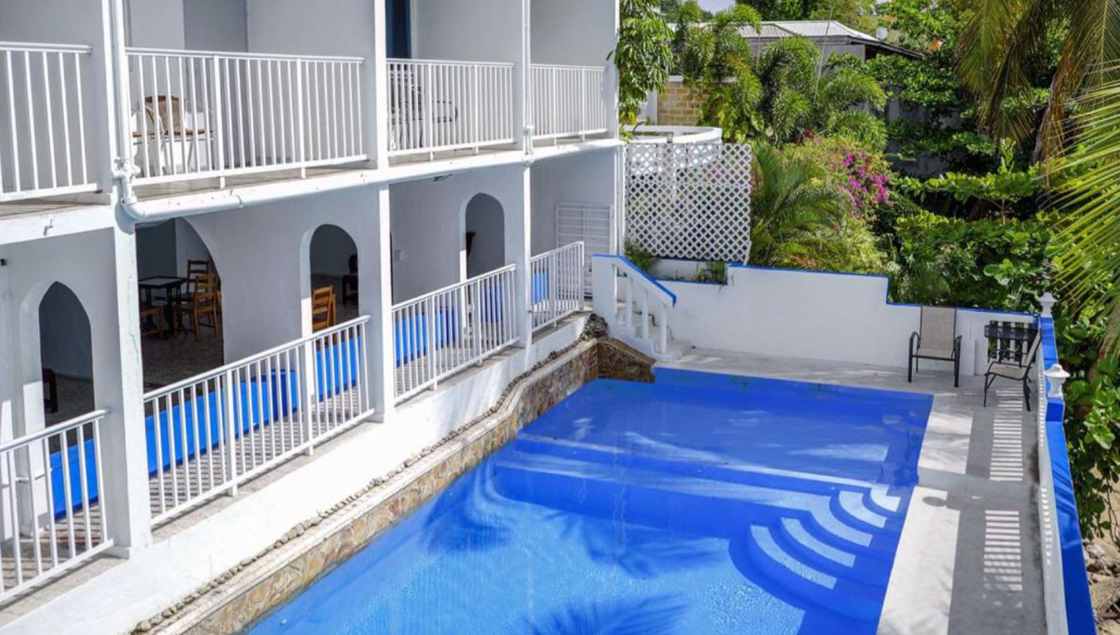
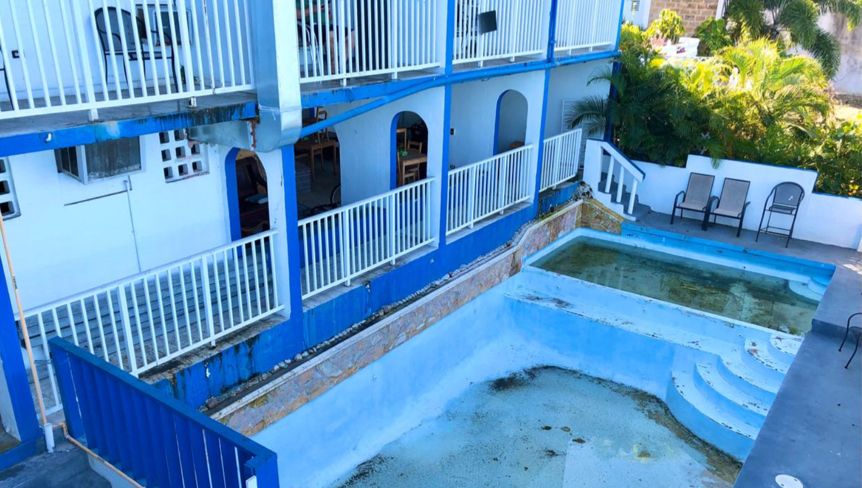
WHY DO HOTEL STARS MATTER MORE THAN EVER?
Generated Facts: The AI Illusion of Hotels

Slide 21
WHY DO HOTEL STARS MATTER MORE THAN EVER?
Generated Facts: The AI Illusion of Hotels

Slide 22
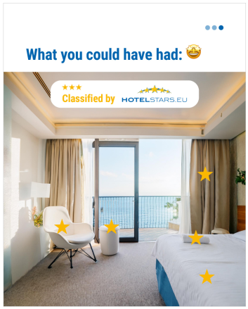
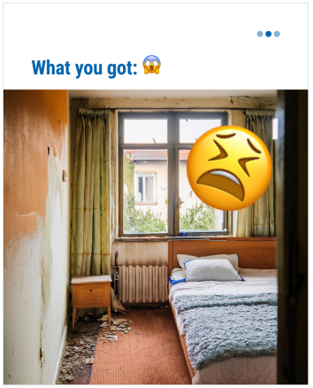
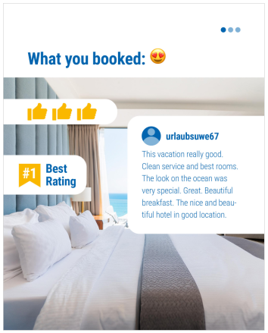
WHY DO HOTEL STARS MATTER MORE THAN EVER?
Verified by HSU

Slide 23
WHY DO HOTEL STARS MATTER MORE THAN EVER?
Verified by HSU

Slide 24
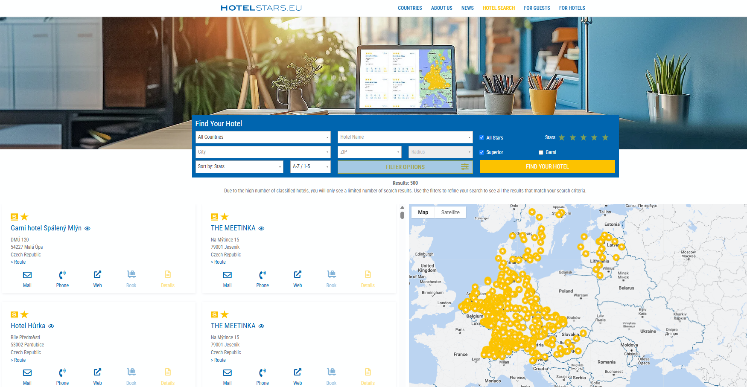

WHY DO HOTEL STARS MATTER MORE THAN EVER?

Slide 25









International Distribution Channels

Slide 27
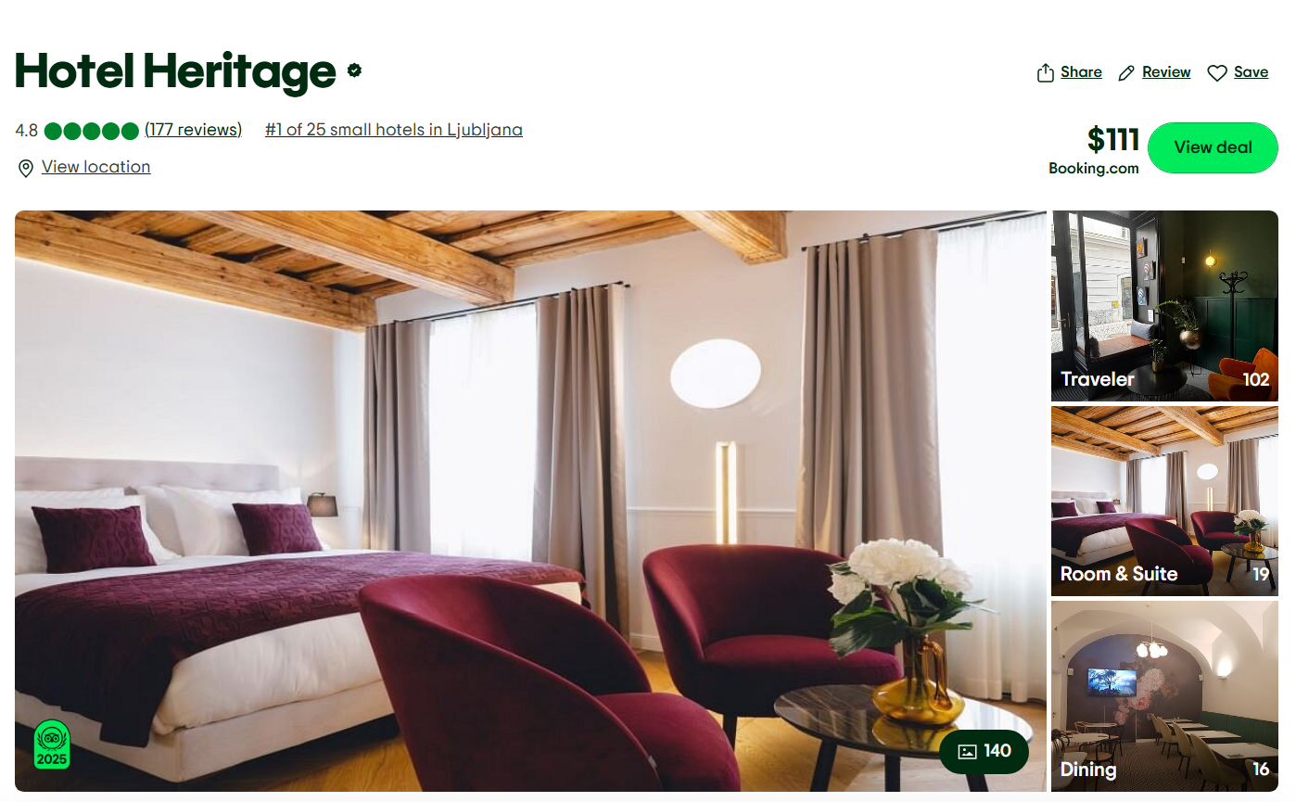
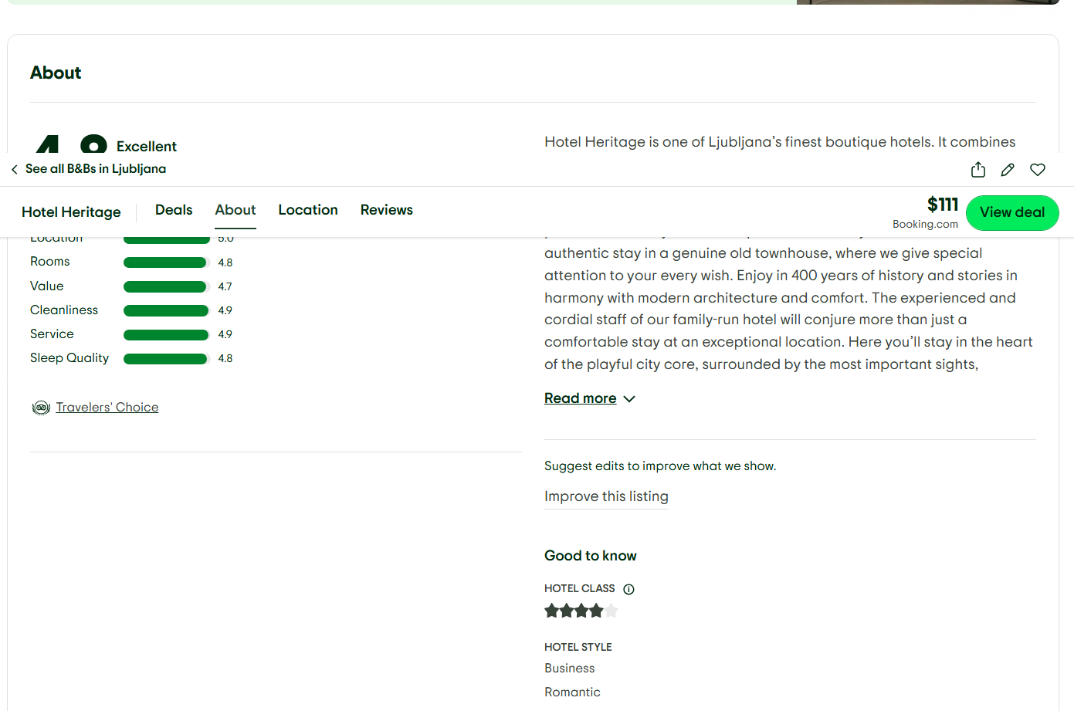

Slide 28
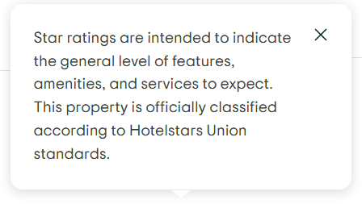

Slide 29
International Distribution Channels

Slide 31
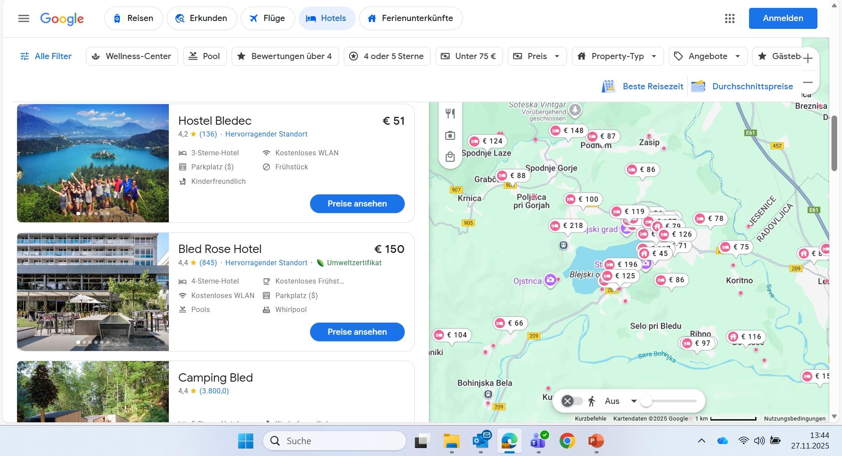

Slide 32

International Distribution Channels

Slide 33


Slide 34
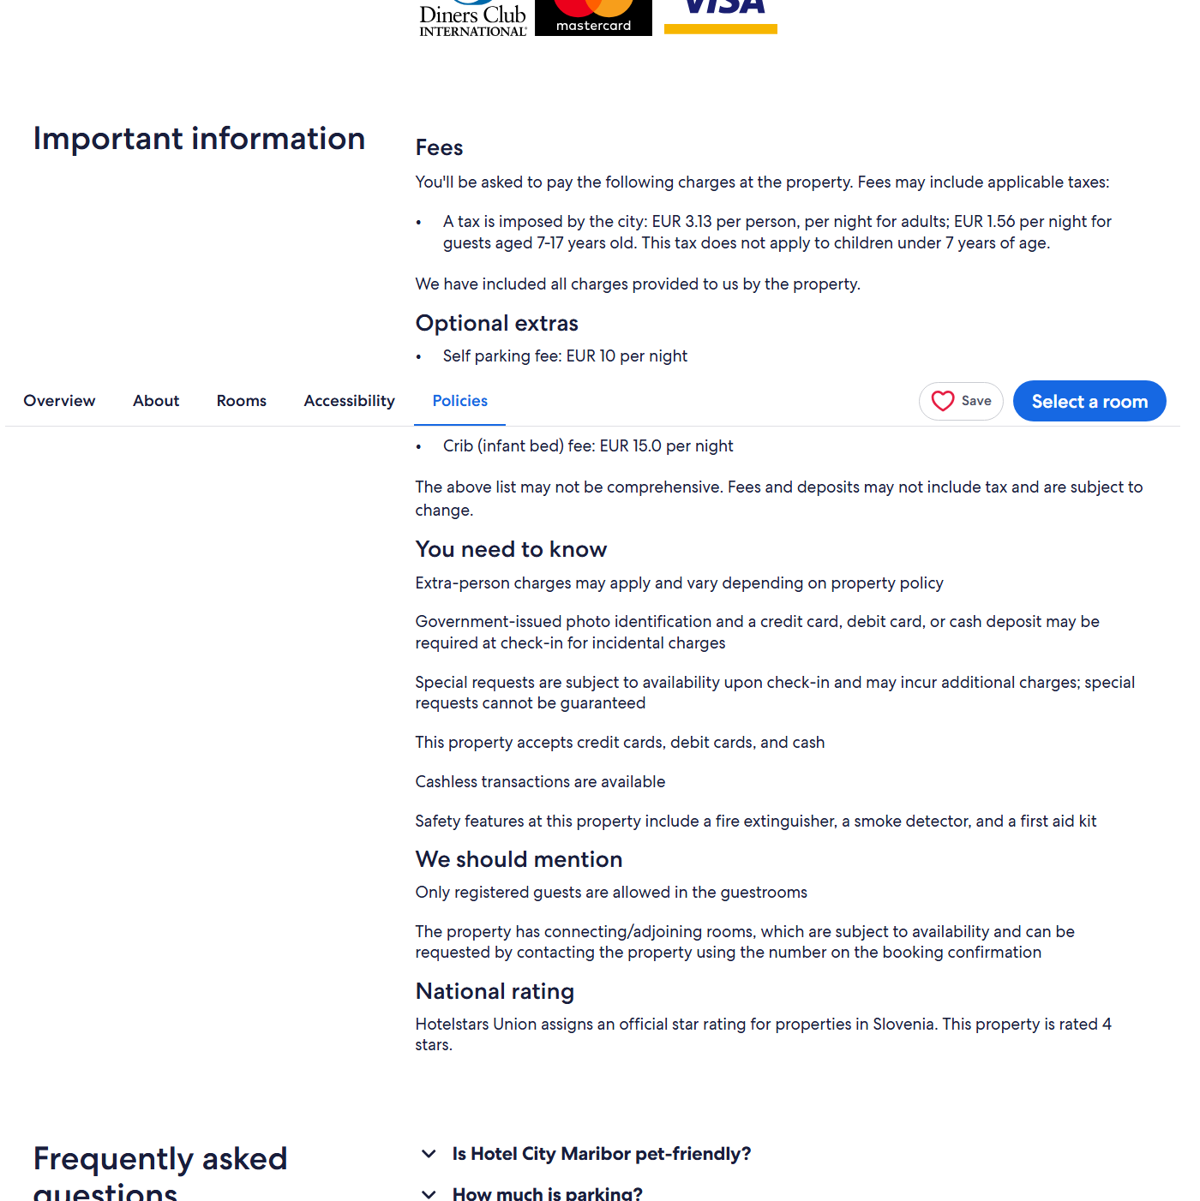
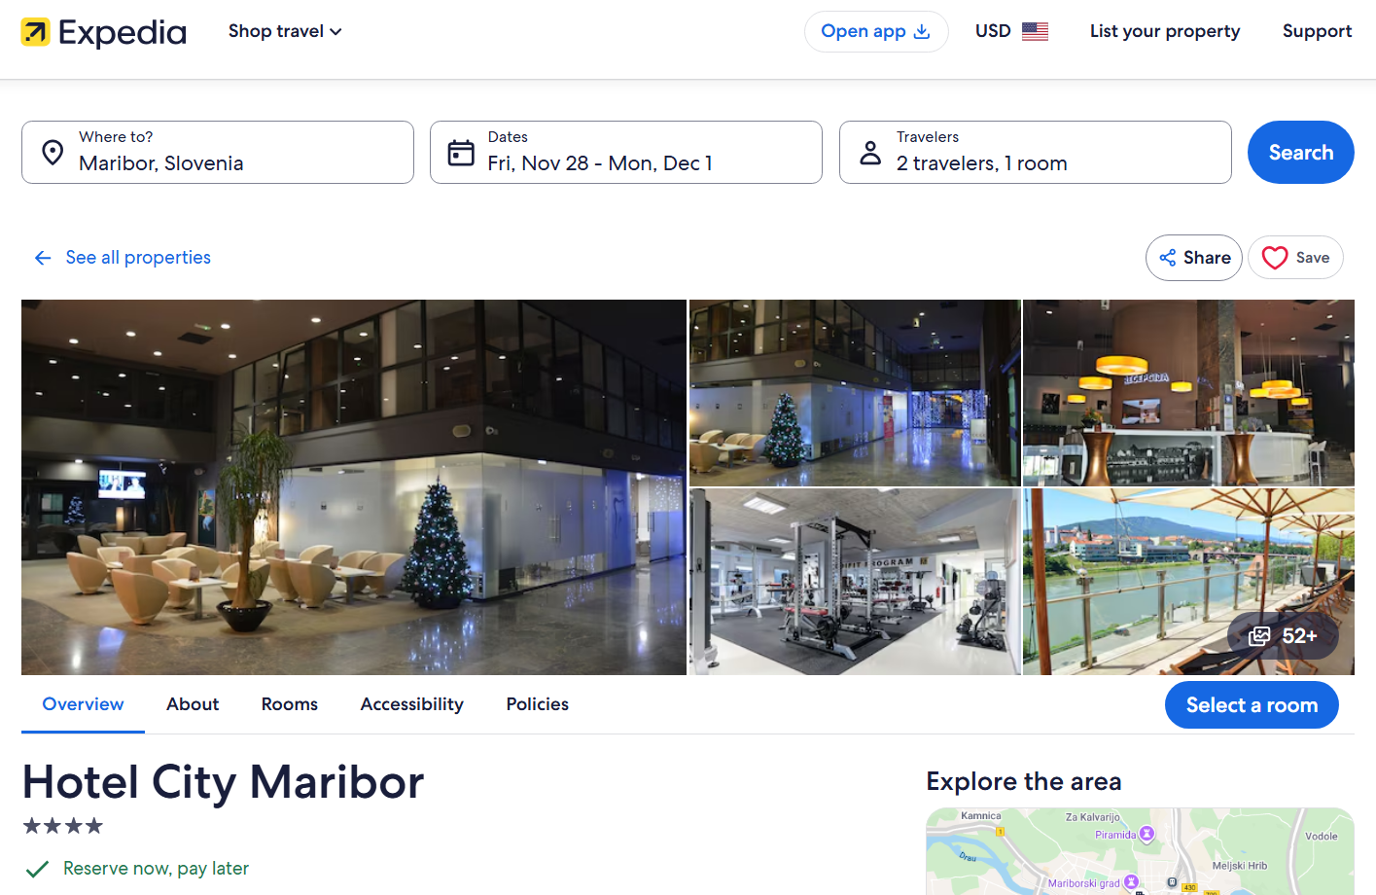

Slide 35


Slide 36

TIME FOR YOUR QUESTIONS

Slide 37
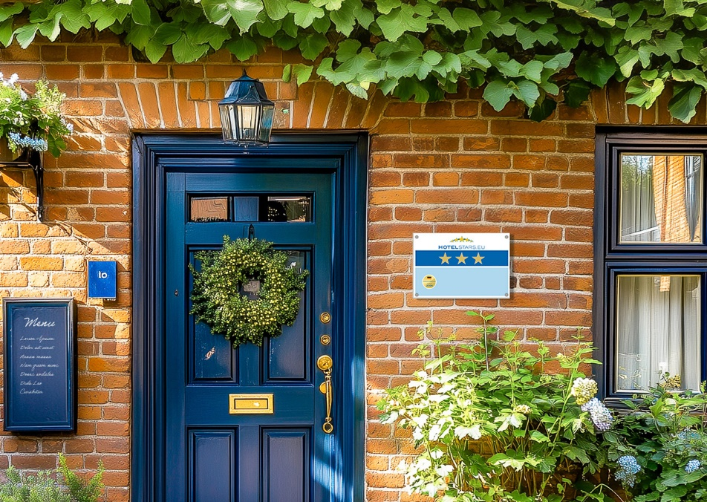
Hvala za vašo pozornost!
Bled, 2nd December 2025
Hotelstars Union AISBL
Square de Meeûs 23
1000 Brussels | Belgium
E office@hotelstars.eu
W www.hotelstars.eu

